Slide 1
Introduction to Calculus

Slide 2

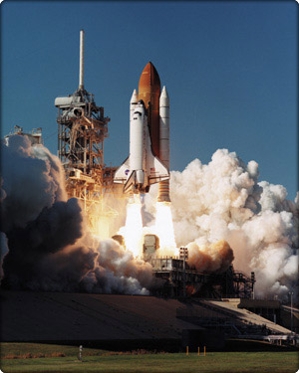

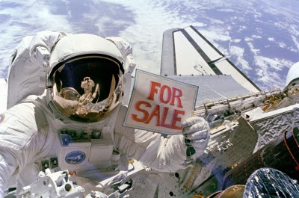

What Do You Think?
What things could be considered the greatest achievements of the human mind?

Slide 3
It's the Greatest!
Consider that all these things emerged because of technological advances
Those advances relied on CALCULUS !
Calculus has made it possible to:
Build giant bridges
Travel to the moon
Predict patterns of population change

Slide 4
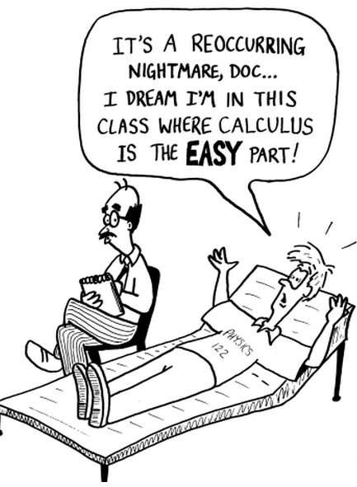

Slide 5
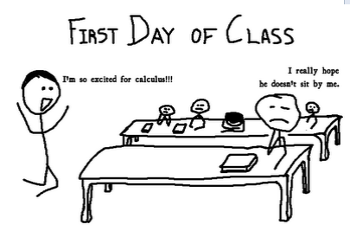

Slide 6
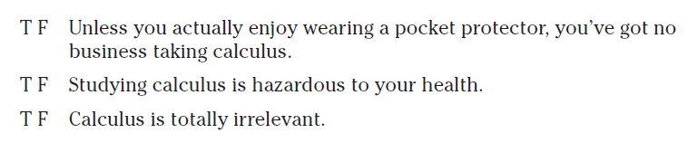
True or False?

Slide 7
The Genius of Calculus is Simple
It relies on only two ideas
The Derivative
The Integral
Both come from a common sense analysis of motion
Motion is change in position over time
All you have to do is drop your pencil to see it happen

Slide 8
What Is Calculus
It is the mathematics of change
It is the mathematics of
tangent lines
slopes
areas
volumes
It enables us to model real life situations
It is dynamic
In contrast to algebra/precalc which is static

Slide 9
What Is Calculus
One answer is to say it is a "limit machine"
Involves three stages
Precalculus/algebra mathematics process
Building blocks to produce calculus techniques
Limit process
The stepping stone to calculus
Calculus
Derivatives, integrals

Slide 10
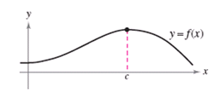
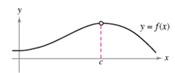
Contrasting Algebra & Calculus
Use f(x) to find the height of the curve at x = c
Find the limit of f(x) as x approaches c

Slide 11


Contrasting Algebra & Calculus
Find the average rate of change between t = a and t = b
Find the instantaneous rate of change at t = c

Slide 12
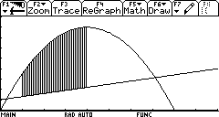
Contrasting Algebra & Calculus
Area of a rectangle
Area between two curves

Slide 13
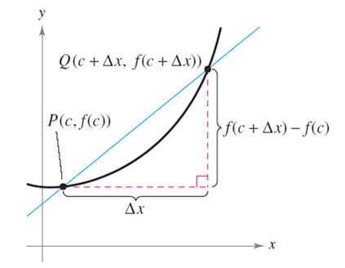
Tangent Line Problem
Approximate slope of tangent to a line
Start with slope of secant line

Slide 14
Tangent Line Problem
Now allow the Δx to get smaller

Slide 15
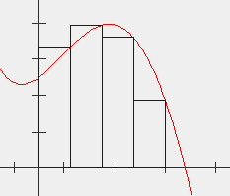
The Area Problem
We seek the area under a curve, the graph f(x)
We approximate that area with a number of rectangles
Sum = 31.9
Actual = 33.33

Slide 16
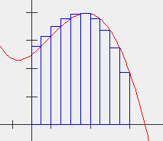
The Area Problem
The approximation is improved by increasing the number of rectangles
Number of rectangles = 10
Sum = 32.92
Actual = 33.33

Slide 17
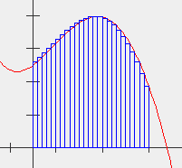
The Area Problem
The approximation is improved by increasing the number of rectangles
Number of rectangles = 25
Sum = 33.19
Actual = 33.33

Slide 18
Thank you
Questions ?
What have you learned ?
What we will see tomorrow ?
Homework

